Slide 1
Humanoid Robot Winter School
February 2017
Blue Team
Notes:
<number>

Slide 2
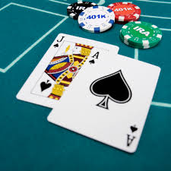
Objective
Play a card game with iCub and incorporate:
Two different vision algorithms
Two different motion algorithms (pushing, pulling)
Contact finger detection
Mood expression (face + speech)

Slide 3
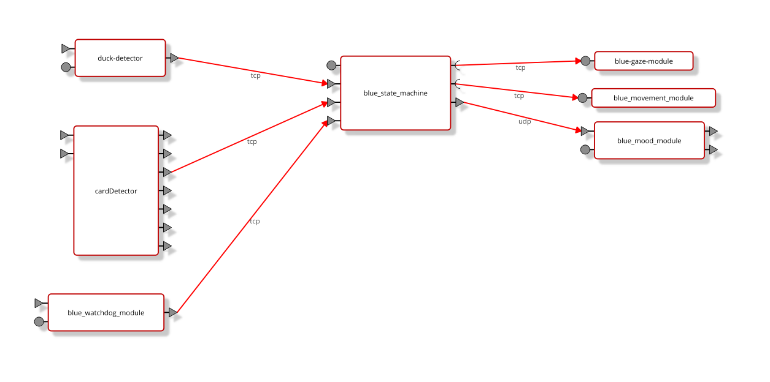
Architecture

Slide 4
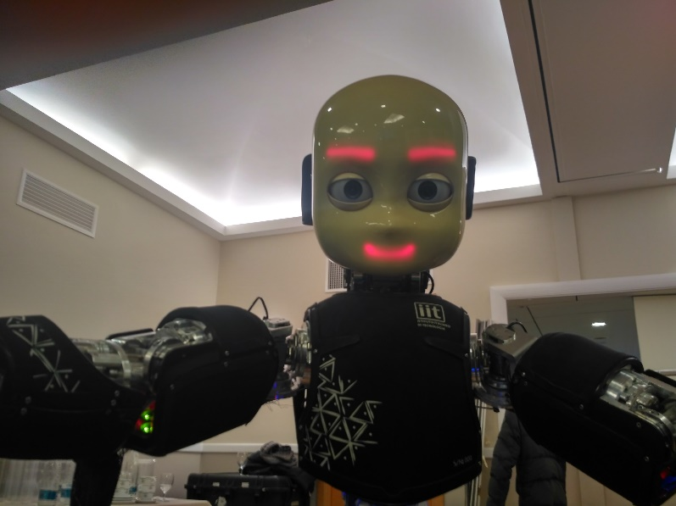

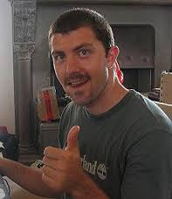
Ideal Scenario/ Start

Slide 5
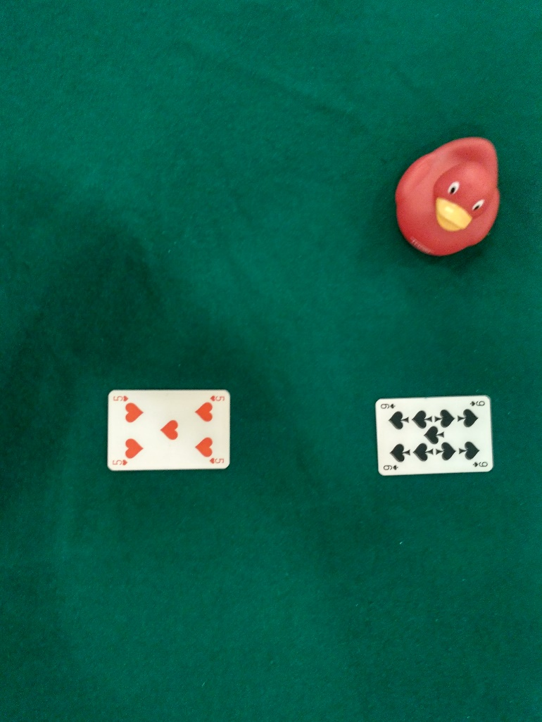
Ideal Scenario/ Dealer sets up the game

Slide 6
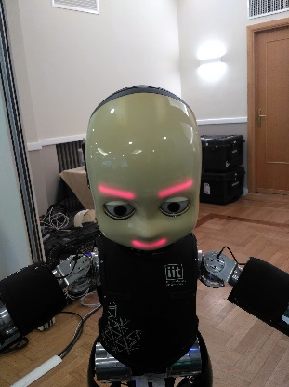
Ideal Scenario/ Look down

Slide 7
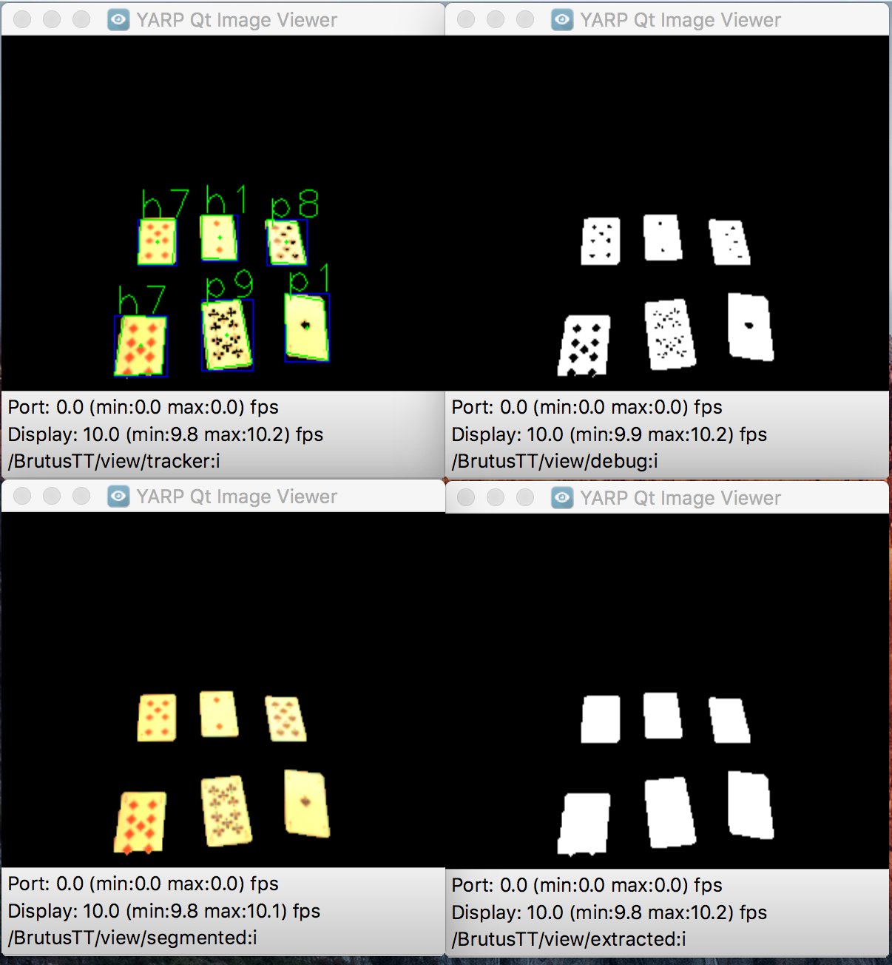
Ideal Scenario/ Read cards and evaluate
My score is 9.
The other card is 5.

Slide 8
Ideal Scenario/ Bet decision
My score is bigger.
Let’s bet !

Slide 9
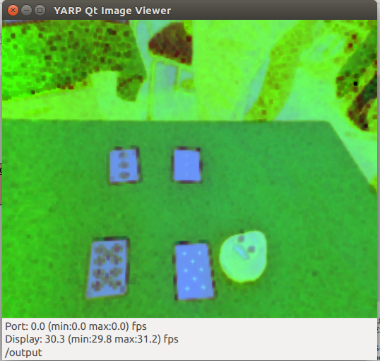
Ideal Scenario/ If bet: check duck position
Duck position is …

Slide 10
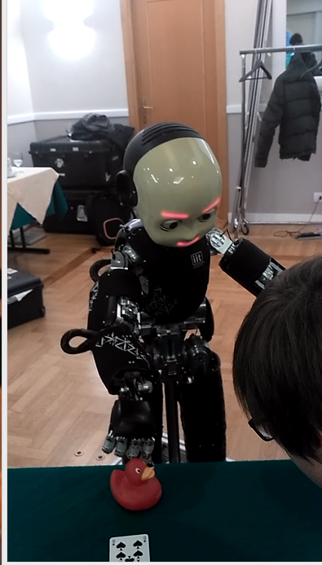
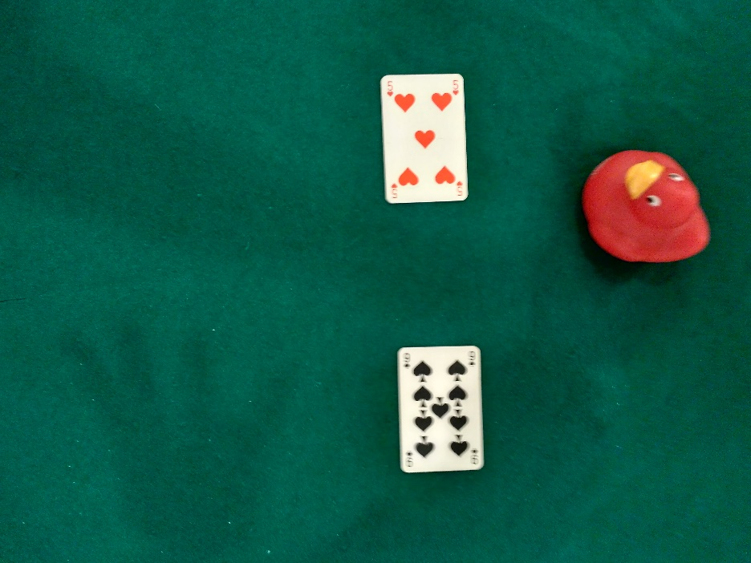
Ideal Scenario/ duck move

Slide 11
Ideal Scenario/ home arm

Slide 12
Ideal Scenario/ look up

Slide 13
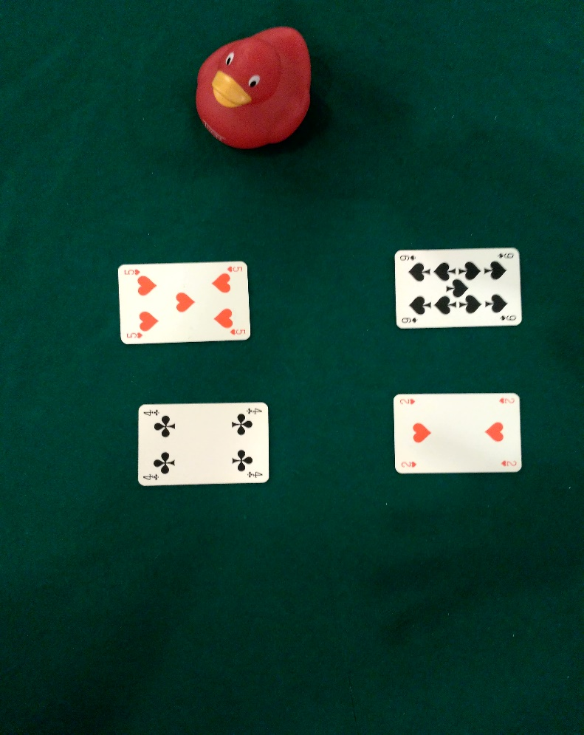
Ideal Scenario/ dealer distribution

Slide 14
Ideal Scenario/ Read cards and evaluate game outcome
My score is 11.
The other score is 9.
I won !

Slide 15
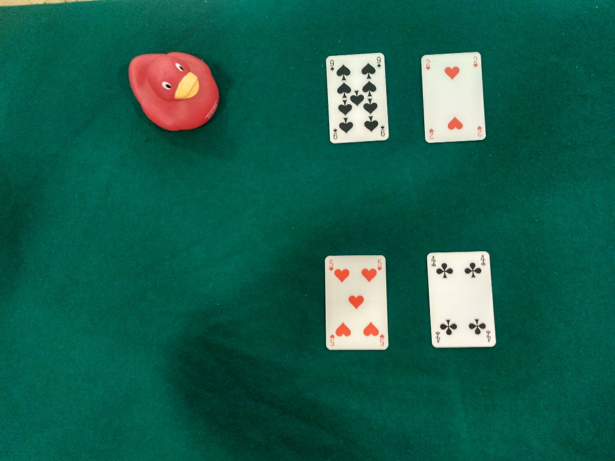
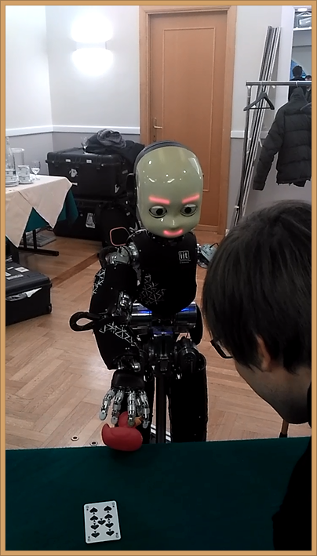
Ideal Scenario/ If won : take the duck back

Slide 16
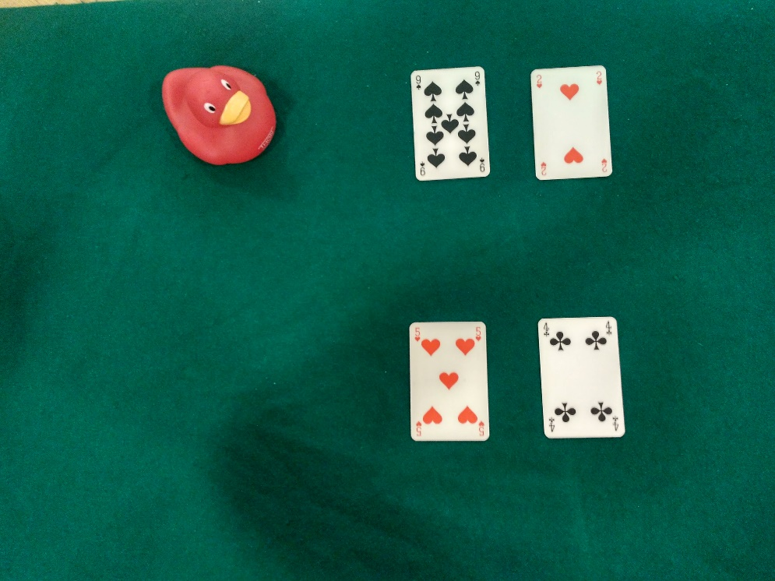
Ideal Scenario/ Report the outcome and ask for next game

Slide 17
Future work
proper state machine implementation with C++ switch or a hierarchical state machine framework.
error handling on different levels
watchdog module integration
interactive gaze (face tracking or objects tracking depending on situation)
more cards, complex decision strategies
handling several objects for betting
torque controlled movements for safe interaction for card sliding

